Slide 1
Flight Delay Analysis
Presenter:- Group 4
Aanchal Ameta
Lakshman
Neeraj
Janaki
Mahalaxmi
Sahith
Preethi

Slide 2
Key highlights:-
Total Flights Analysis: 5.82M
JetBlue Airways Cancellations: 4,276
Airline with highest/lowest number of Arrival delay: Southwest Airline co./Virgin America
Airline with highest/lowest number of Departure delay: Southwest Airline co./Hawaiian Airline Inc.
No. of average arrival delayed flight: 2087K
No. of average arrival delayed flight: 2126K
Long-Distance Flight Reliability: 66.33%

Slide 3
Introduction:-
Flight delays are a major concern for both passengers and airlines, leading to customer dissatisfaction and financial
losses in Business. Airlines and airports need better insights into delay patterns to improve operational efficiency
and on-time performance.
The objective of this project is to identify and highlight factors that contribute to flight delays across different airlines
, states, and days of the week.
Objective:-
Analysis of Weekday Vs Weekend total flights statistics
Identify which airlines, States, city, or time periods (day of week) show the most delays.
Number of airlines with No delay with certain distance.

Slide 4
Data flow diagram :-
Excel (Data Cleaning and Preparation)
Power Bi (Data Modeling and KPI Dashboard)
Tableau (interactive visualization and story telling)
MySQL (Backend queries , Data Validation and Storage)

Slide 5
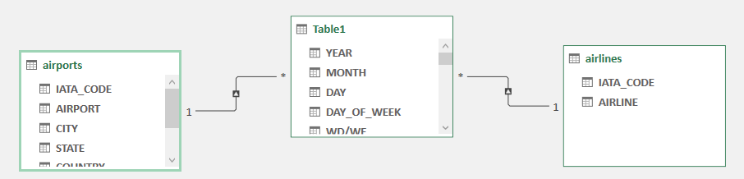
Excel:-
Purpose:- Prepare and clean row data for Analysis and Making Dashboard.
Work Done:-
Data loaded in power query editor.
Checked Data Types , Promoted Headers, Replaced Null Values, Trimmed, Cleaned etc.
Created relationships with the help of Data Modeling Power Pivot Manage Diagram View
(1.Flights table – Origin Airport column & Airport table – IATA_Code column,
2. Flights table - Airline column & Airline table – I IATA_Code column)
Created preliminary pivot charts to check delay patterns (by weekday, weekend, airline, state and city).

Slide 6
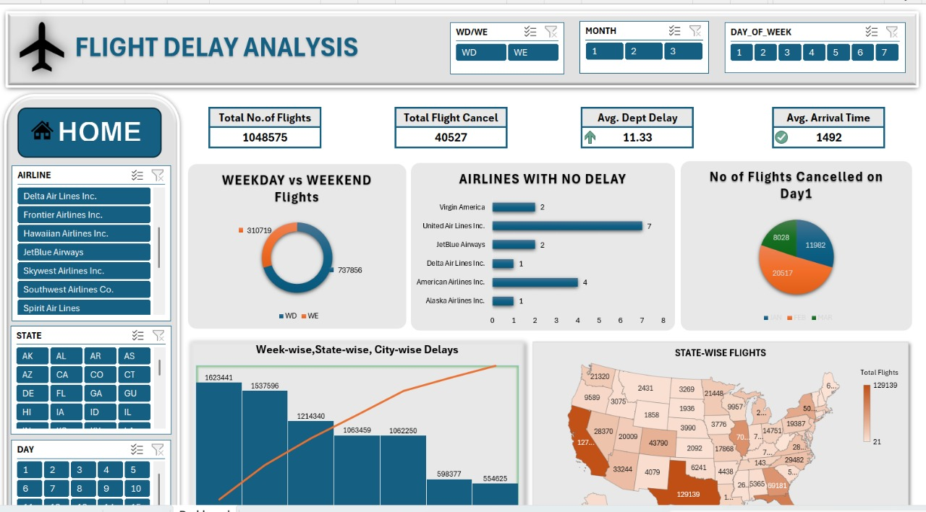
Dashboard Created:-
Basic Excel dashboard showing Average Delay, Cancelled Flights, weekend weekday flight analysis and delay patterns state wise, city wise, airline wise.

Slide 7
Challenges Faced:-
Handling Large Dataset (5M+ rows) – Excel Slowed Down significantly.
Some column requires reformatting.
Find and replacing empty values and cleaning large data was time consuming.
Finding correct common columns to create relations so in pivot chart we wont get blanks.
Limited visualization flexibility compare to BI tools.

Slide 8
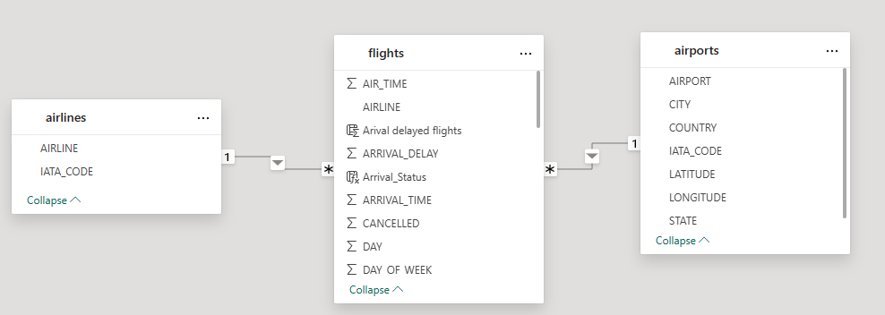
Power BI – KPI Analysis and Visualization
Purpose:
To build KPIs and visualize overall airline performance metrics.
Tasks Done:
Imported data into Power BI.
Cleaned data using power query.
Created relationship among Flight, Airline and Airport table in data modeling.
(1.Flights table – Origin Airport column & Airport table – IATA_Code column,
2. Flights table - Airline column & Airline table – I IATA_Code column)
Created new columns and Built measures using DAX such as arrival, departure status, Airline with no delays, weekend/weekday flight statistic.

Slide 9
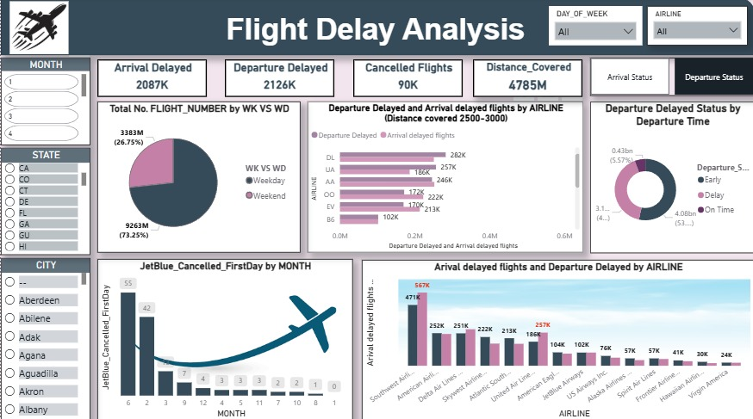
Dashboard Created:-
Interactive Power BI dashboard for operational insights

Slide 10
Developed visuals:
Weekday Vs Weekend total flights statistics
Total number of cancelled flights for JetBlue Airways on first date of every month.
Week wise, State wise and City wise statistics of delay of flights with airline details.
Number of airlines with No departure/arrival delay with distance covered between 2500 and 3000
Given slicers for city, states, Month, Days of week to filter out the exact result we want.
Challenges Faced:
Difficulty writing DAX formulas initially (especially with relationships).
Data model performance slowed down due to large datasets.
Filtering out Null and negative values to perform correct calculations.
Filtering visuals to exclude irrelevant or incomplete records required attention.

Slide 11
Tableau – Storytelling and Interactive Insights.
Purpose:
To create advanced, visually rich dashboard and tell a clear data story.
Task Done:
Data loaded in Data Source Pane and created relationship in logical layer.
Designed visuals such as:
Week wise average delay (Line Chart)
State Wise no. of Airports (Map Chart)
Airline wise flight details (lollypop Chart)
Weekday vs Weekend delay comparison (Bar Chart)
Used Calculated fields and filters to remove null/negative delay values.

Slide 12
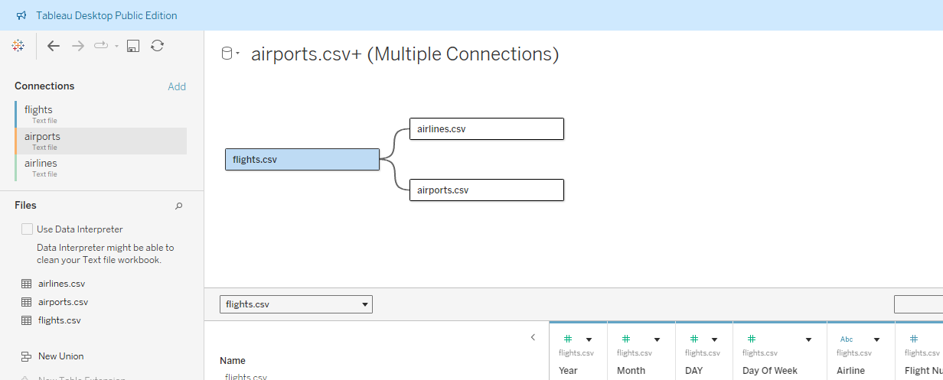
Combined Visuals into a final story dashboard.
Created relationship among Flight, Airline and Airport table in data modeling.
(1.Flights table – Origin Airport column & Airport table – IATA_Code column,
2. Flights table - Airline column & Airline table – I IATA_Code column)

Slide 13
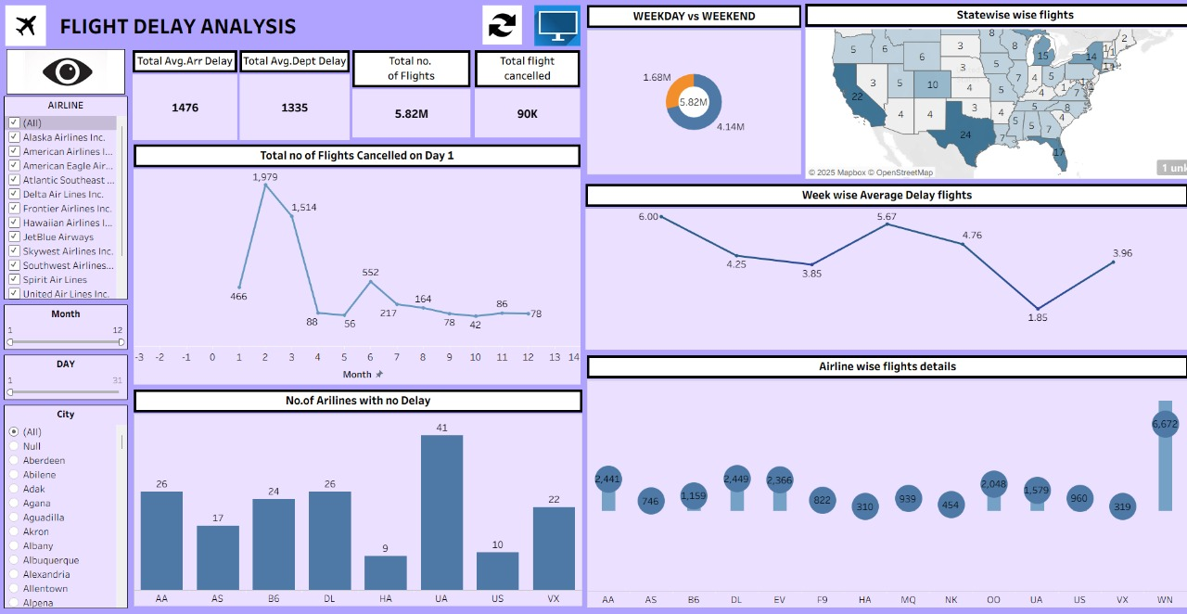
Dashboard Created:-
Dynamic and visually appealing Tableau dashboard summarizing overall findings.

Slide 14
Challenges Faced:
Tableau initially hid axis options — difficult to edit labels or scales.
Adjusting x/y-axis positions and enabling hidden axes took troubleshooting.
Performance slowed when loading large datasets with multiple filters.
Combining multiple sheets into one cohesive Dashboard required fine layout adjustment.
Ignoring null negative values in calculations.
Making lollypop and donut chart which was not readily available.

Slide 15
MySQL – Backend Queries and Data Validation.
Purpose:
To store, query, and validate the analytical data efficiently.
Tasks Done:
Loaded datasets into MySQL using Load data local infile.
Ran SQL queries to validate and calculate KPIs:
Weekday Vs Weekend total flights statistics.
Total number of cancelled flights for JetBlue Airways on first date of every month.
Week wise, State wise and City wise statistics of delay of flights with airline details.
Number of airlines with No departure/arrival delay with distance covered between 2500 and 3000.
Top 10 Cities with no delay State wise
Verified Power BI and Tableau outputs using SQL query results.
Output:
Reliable backend data validation and computation layer.

Slide 16
Challenges Faced:
Encountered Error 2068 while loading CSV (LOCAL INFILE restriction).
AIR_TIME column gave “Out of range” warnings due to incorrect data type (needed to convert to INT).
Managing such a large dataset required careful indexing and type selection.
Troubleshooting data import paths (especially Windows file directory issues).
While creating table we have missed taxi out column due to that we were getting 0 for 4th kpi
(which is Number of airlines with No departure/arrival delay with distance covered between 2500 and 3000)

Slide 17
Key Insights:-
Identified key drivers of flight delays across 5.8M+ records, enabling actionable insights into operational efficiency, scheduling optimization, and network reliability.
1. The weekday flight volume is significantly higher than weekends, which directly correlates with increased arrival and departure delays.
Business Action:
Airlines should deploy additional staffing, gates, and buffer schedules on weekdays to manage peak demand more effectively.
2. JetBlue Airways recorded a notably higher number of cancelled flights on the first day of each month compared to other days.
Business Action:
Review monthly planning processes to reduce predictable cancellations and improve customer reliability at month start.
3. The KPIs show ~2.09M arrival-delayed flights and ~2.13M departure-delayed flights, indicating a strong dependency between the two.
Business Action:
Prioritizing early arrival recovery can significantly reduce downstream departure delays and network disruption.
4. Southwest Airlines consistently recorded the highest arrival and departure delays, while Virgin America and Hawaiian Airlines showed better on-time performance.
Business Action:
Benchmark low-delay airlines to identify best practices in scheduling, turnaround, and fleet utilization.
5. Flights covering 2500–3000 miles achieved 66.33% reliability, with several airlines experiencing zero arrival or departure delays in this segment.
Business Action:
Apply long-haul scheduling strategies (buffer planning, turnaround windows) to improve short-haul reliability.

Slide 18
Thank you

